Slide 1

POWER POINT PRESENTATION
On
PROJECT- CAMPUS CONNECT
DEPARTMENT OF COMPUTER SCIENCE & ENGINEERING
Presented By:
Project Group (B.Tech CSE Project phase-II) -10
Mr. Rushikesh Katkar.
Mr. Shubham Ghadge.
Mr. Nishant Dhumal.
Guide : Mr. Pathak P. A.

Slide 2
CONTENTS
INTRODUCTION
PROBLEM STATEMENT
OBJECTIVE OF THE PROPOSED WORK
LITERATURE REVIEW
SYSTEM ARCHITECTURE
EXISTING SYSTEM
SOFTWARE REQUIREMENTS
RESULTS
CONCLUSIONS
FUTURE SCOPE

Slide 3
INTRODUCTION
Campus Connect is the platform on which user can figuring out in which company they can apply and user also search companies according their interest and get information about their placement criteria.
This platform shows result according the user interest and help to get companies,
And it gives the list of companies in which job is available according to users skills and experience.
This platform is also useful for Training and Placement Officers (TPO) and companies to easily shortlist students. Companies can add new vacancies to this portal, and students will receive email notifications about these opportunities.

Slide 4
INTRODUCTION
For companies, our portal serves as a strategic recruitment hub. When seeking to hire professionals, organizations can effortlessly post job vacancies, internship positions, or project opportunities directly on our platform. This information is then disseminated to students and relevant academic authorities, such as Training and Placement Officers (TPOs), ensuring that the right talent pool is aware of these opportunities.

Slide 5
PROBLEM STATEMENTS
To develop an innovative digital platform on which user can find companies according the different criteria’s of company. To build platform for students which reduce much time of students to find the companies according their percentage criteria. To provide an online web platform for college students and industry job seekers according their skills.
Key Issues to Address:
Lack of personalized job recommendations based on academic performance for students.
Inefficient communication channels for companies to reach the right candidates.
Time-consuming and cumbersome job-search processes for both students and companies.
Limited transparency in accessing and disseminating job-related information.

Slide 6
OBJECTIVE
To develop a website for students and job seekers.
To filter best companies according to skills and criteria of the company.
To give the information of companies according to the user inputs.
To add new vacancies to this portal, making it easy for students to view and apply for these opportunities.

Slide 7
LITERATURE REVIEW
Author name | Paper name | Publication Year | Important Points
Suraj Gupta | “Recruitment System with Placement Prediction”, IEEE | 2021 | This concept is used in the next step to determine or predict employee placement based on their characteristics. system aims to analyze the performance and possible suitable candidates for the job using the random forest method.
^{Mr. Nilesh Rathod} | An Interactive Online Training and Placement System” , IEEE | 2013 | College Talent Placement System aims at providing the facility to automate and simplify the process of registration and list generation of eligible students for placement
^{Prof. Shilpa Hadkar} | “College Collaboration Portal with Training and Placement”, IEEE | 2014 | The project will include minimum manual work and maximum optimization, abstraction and security. Students will get notified when TPO’s upload study material or any campus drive information, through this system. Automatic Training and placement is developed to maintain the details of student information, trace the details of student also maintain the information about the company availability.

Slide 8
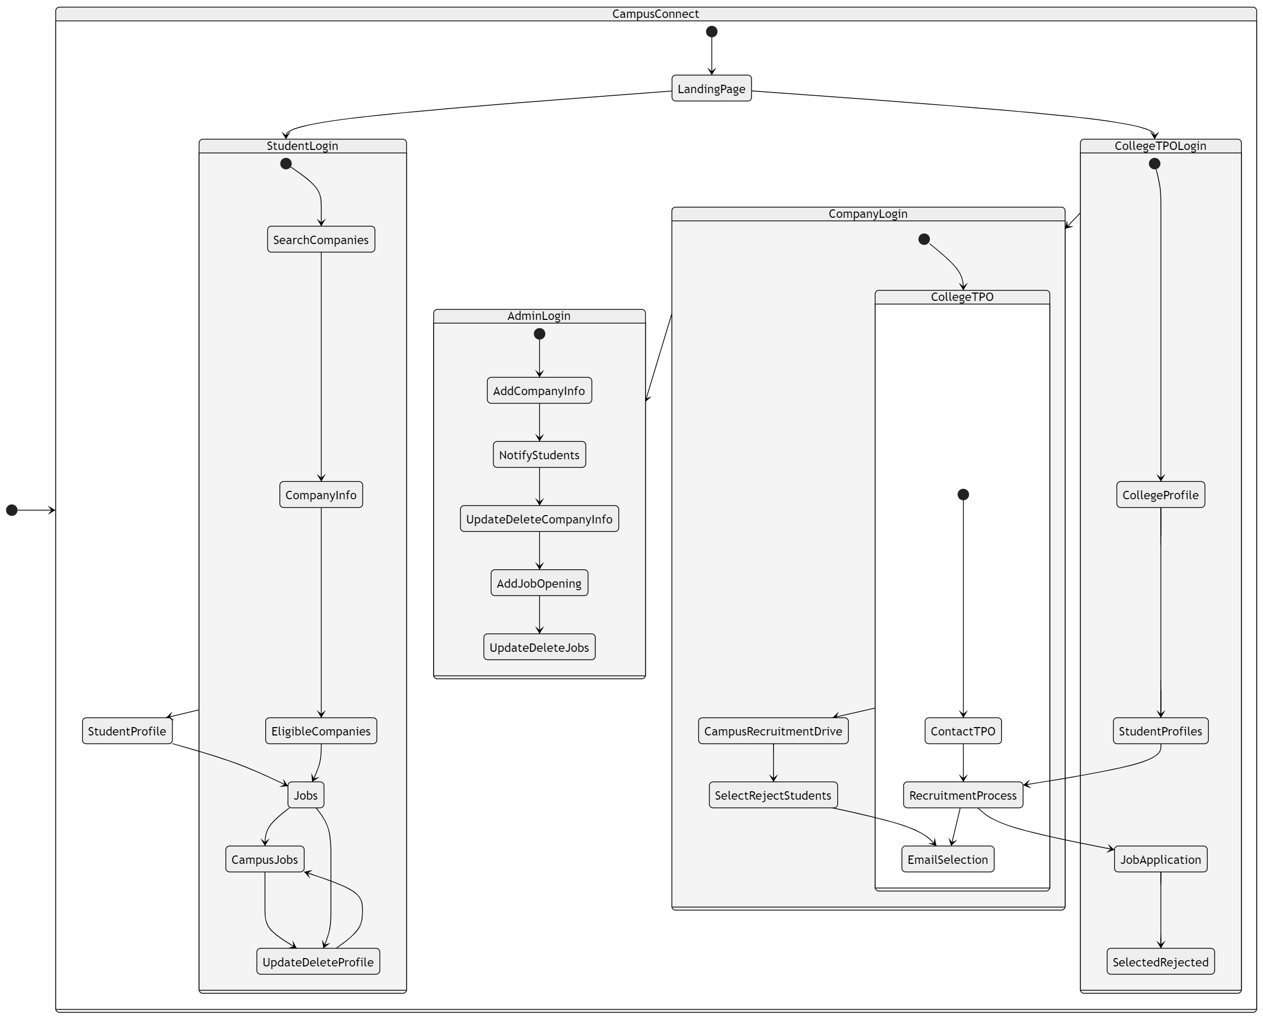
SYSTEM ARCHITECTURE

Slide 9
EXISTING SYSTEM
Nowadays, various type of platform present in digital word. There are so much related to education. In literature survey we studied few research papers. According to our study most of platforms for job notification provider.
According to all other paper related to particular method like they provide job description and notification and some of that are provide user skill analysis. They are separate but not in one so that students depends on multiple platforms.
We found many issue on that paper and implement those things on our project. We found most important issue is student does not know that in which companies they can approach for placement.
To provide more interactive performance and sharing platform that can easily access. It is more helpful for educational institute to keep student up to date . This module we can open any device like mobile, desktop, tab.

Slide 10
SOFTWARE REQUIREMENTS
Software Required
Server:
Nodejs Environment for backend
Express.JS Framework
Mongo DB
Atlas
Development:
Visual Studio Code
Html
Css
Javascript
React

Slide 11
RESULTS
You can find the list of company names in which you can approach.
You can get company career page information.
User can analyze their skills for the any job post in particular company.
User can get idea about that which type and level questions are asked by interviewer in interviews.

Slide 12
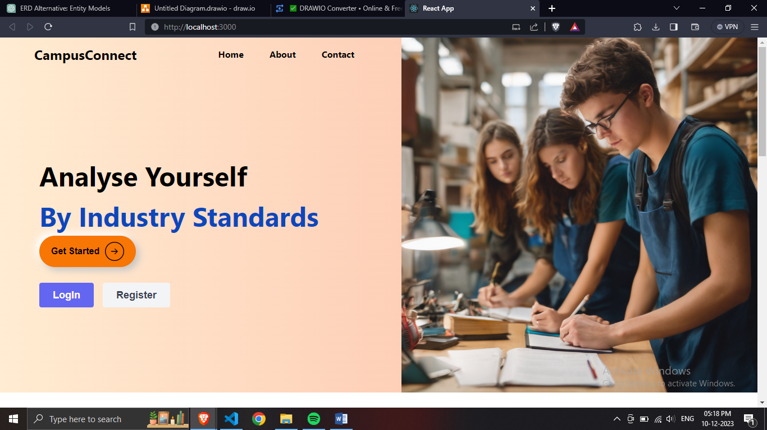
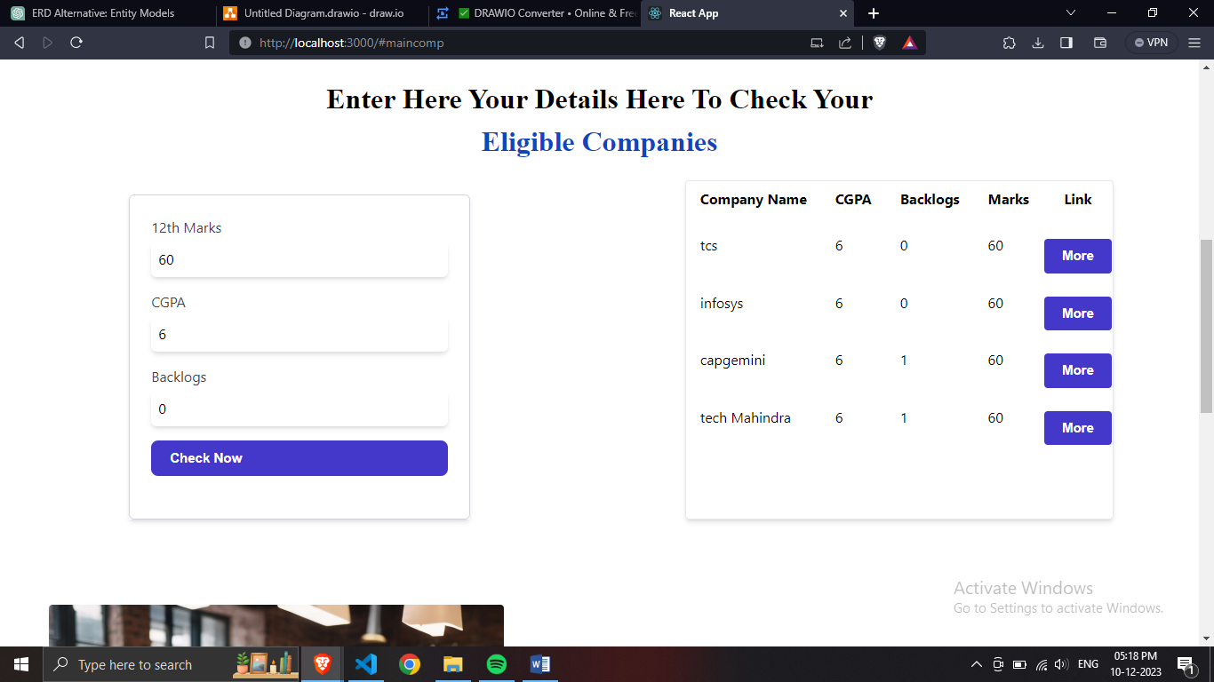
RESULT
Home Page
Input and Output

Slide 13
CONCLUSIONS
The project entitled as Campus Connect is the system that deals with the issues related to Students and their Placements.
This project is successfully implemented with all the features mentioned in system requirements specification.
The application provides appropriate information to users according to the chosen service.
The project is designed keeping in view the day to day problems faced by a student and job seekers.
Automation of the entire system improves the efficiency
It provides a friendly graphical user interface which proves to be better when compared to the existing system.

Slide 14




FUTURE SCOPE
It may help students practice the questions on same platform and enhance their chances of getting placed.
It will help someone who is looking for better opportunity and work culture.
It reduces much time to find out the companies in which user can apply.
Can send suggestion emails to candidate according their profile and skills.

Slide 15
Any Queries…….?

Slide 16
THANK YOU!!

